Slide 1
NoSQL

Slide 2
Agenda
What is RDBMS?
Is RDBMS dead?
Can we write a simple RDBMS?
What is NoSQL?
Xelerate and NoSQL

Slide 3
What Is RDBMS?

Slide 4
Data, Database and DBMS
Data
Numerical, character
Schema
Structure of data, It sets the rules which the data must obey
Database
Collection of related data, arranged for speedy search and retrieval
Database Management System
Collection of programs that allows users to specify the structure of database, to create, query and modify data in database and to control access to it.

Slide 5
Structured Query Language
Language used by RDBMS
Programming language for accessing and managing data in relational database.
DML
DDL

Slide 6
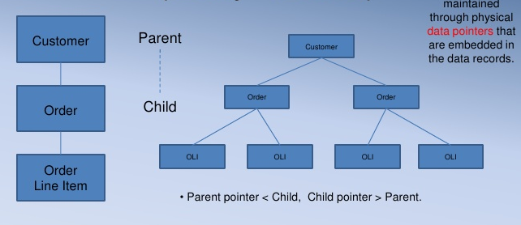
Early database systems
Hierarchical database model
Links are maintained through physical data pointers which are maintained in the data itself.

Slide 7
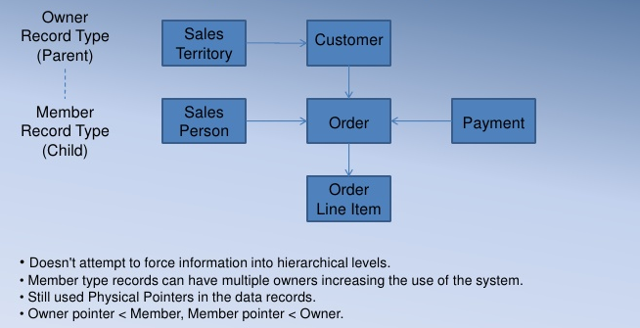
Early DBMS contd..
Network Database Model

Slide 8
RDBMS
Most popular database system
Model is based on tables, rows and columns and the manipulation of data stored
Relational database is a collection of these tables
Single database can be spread across several tables
Oracle, DB2, Sybase, MySQL and SQL server

Slide 9
Relational Data Model Terminology
Relation
Table or flat file with columns and rows
Tuple
Row of a relation and represents an instance of the relation
Attribute
Named column of a relation
Cardinality
Number of rows in a table
Key Constraints
Primary Key
Unique identifier for the relation
Foreign Key
Attribute in a relation which is also the primary key of another relation

Slide 10
Value of RDBMS
Persistent Data
RDBMS allows more flexibility than a file system in storing large amounts of data in a way that allows an application program to get at small bits of that information quickly and easily.
Concurrency
Relational databases help handle this by controlling all access to their data through transactions.
Integration
RDBMS allows all the applications to use each others’ data easily, while the database’s concurrency control handles multiple applications in the same way as it handles multiple users in a single application.

Slide 11
Value of RDBMS contd…
Standard Model
Relational databases have succeeded because they provide the core benefits we outlined earlier in a (mostly) standard way.
Although there are differences between different relational databases, the core mechanisms remain the same.
Different vendors’ SQL dialects are similar, transactions operate in mostly the same way.

Slide 12
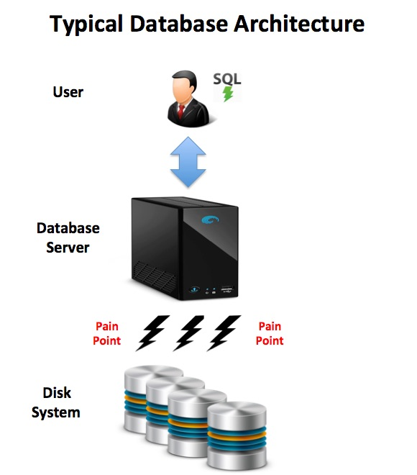
Typical Database Architecture

Slide 13
Relational Data Model
Relational data model consists of a set of tables.
Data will be fully normalized.
Queries involve joining information from multiple tables.
Join is too expensive , impacts performance

Slide 14
RDBMS storage aspects
RDBMS is optimized for space, not for speed.
Normalization removes data duplication and ensures data consistency.
RDBMS schemas are highly normalized to minimize the data storage and to speed up inserts, update and deletes.
High degree of normalization is a disadvantage when it comes to retrieving data, as multiple tables may have to be joined to get all the desired information.
Creating these joins and reading from multiple tables can have a severe impact on performance, as multiple reads to disk may be required.

Slide 15
Limitations of RDBMS
RDBMS were not designed to be run on a cluster.
Clustered relational databases, such as the Oracle RAC or Microsoft SQL Server, work on the concept of a shared disk subsystem.
Use a cluster-aware file system that writes to a highly available disk subsystem—but this means the cluster still has the disk subsystem as a single point of failure.
Commercial RDBMS are usually priced on a single-server assumption, running on a cluster raised the prices.
Partitioning/sharding can separate servers for different set of data, but has to be controlled by the application which has to keep track of which database server to talk to for each bit of data.

Slide 16
Let’s get our Hands Dirty!!
Let’s build a RDBMS of our own..
Employee Table
Insert,Query & Delete an Employee
Data should be stored in a data file and index file.
# | Column Name | Data Type
1 | NAME | String
2 | AGE | Integer
3 | DOB | Date

Slide 17
What is NoSQL?

Slide 18
What is NoSQL?
Not Only SQL.
It’s about recognizing that for some problems, other storage solutions are better.
It’s not about saying that SQL should never be used or SQL is dead.
Usually do not require a fixed table schema nor do they use the concept of joins
NoSQL encompasses a wide variety of different database technologies that were developed in response to a rise in the volume of data stored.
Distributed database.
Horizontally scalable database.

Slide 19
NoSQL – Denormalized storage
For better read/query performance, de-normalize the storage.

Slide 20
Some facts!!!
HBase is used by Facebook to process 80 billion transactions per day
MongoDB – E-Bay, Shutterfly and even Aadhar!!
Cassandra – Netflix(50 clusters, 750 nodes), RackSpace …
IOT
Analytics
Social media

Slide 21
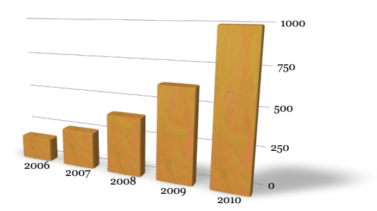
NoSQL – Why now?
Data size :
Modern enterprise systems are expected to handle very large volume of data.
According to a report published by IBM, 90% of the world’s data is created in the last 2 to 4 years.

Slide 22
NoSQL – Why now?
Explosion of social media sites (Facebook, Twitter) with large data needs.
Rise of cloud-based solutions such as Amazon S3 (simple storage solution)
Shift to dynamically-typed data with frequent schema changes
Denormalized data is acceptable for performance benefits
Open-source community behind NoSQL products

Slide 23
Benefits of NoSQL
NoSQL databases are more scalable and provide superior performance.
Dynamic schemas
Auto sharding
Replication
Massive scalability
High availability
Integrated caching
Lower cost

Slide 24
CAP Theorem

Slide 25
CAP Theorem
In theoretical computer science, the CAP theorem, also known as Brewer's theorem, states that it is impossible for a distributed computer system to simultaneously provide all three of the following guarantees
Consistency (all nodes see the same data at the same time)
Availability (a guarantee that every request receives a response about whether it was successful or failed)
Partition tolerance (the system continues to operate despite arbitrary message loss or failure of part of the system)
According to the theorem, a distributed system can satisfy any two of these guarantees at the same time, but not all three.

Slide 26
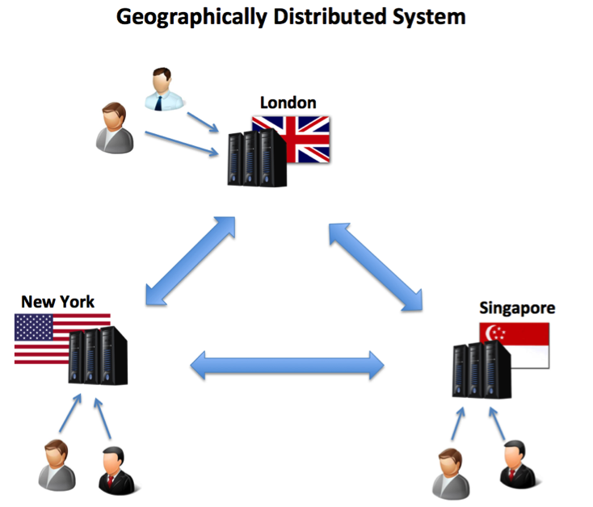
CAP Theorem contd..

Slide 27
Dynamic Schema
Row Key
1
Customer
ID
Name
Age
100
John
30
Row Key
2
Customer
ID
Name
Age
Category
Location
101
Tom
35
CORP
INDIA
Row Key
3
Customer
ID
Name
103
Sam

Slide 28
Challenges of NoSQL
Maturity
Most NoSQL alternatives have matured to production versions with many key features in the pipe line and continuously evolving
Support
Most NoSQL systems are open source projects
Support for each NoSQL database is available
Administration
NoSQL requires a lot of skill to install and a lot of effort to maintain.
Developer expertise
Difficult to find experienced NoSQL expert
Almost every NoSQL developer is in a learning mode

Slide 29
Xelerate and NoSQL

Slide 30
Xelerate and Transaction volume
During early 2000s, Xelerate (TBMS) was expected to handle only few millions of records.
Storing a few millions of transaction is not a big issue with traditional RDBMS.
Prospective customers planning to use Xelerate has got different range of volume handling requirements.
New business opportunities from existing clients like Comcast has got requirements to handle transactions in billions.

Slide 31
Xelerate and Analytics
Xelerate ETL tool or TPE is being utilized as an analytical engine by customers like Comcast.
TPE is expected to collect and process billions of transactions on a daily basis.
Storing billions of transactions in traditional RDBMS will not be an appropriate solution.
Billions of transaction means multiple servers to handle the processing as well as data access.
Processing server as well as storage server has to be clustered horizontally.
Bringing in NoSQL storage capabilities in Xelerate is the most appropriate solution.

Slide 32
Is Xelerate moving away from RDBMS?
Xelerate storage architecture will be totally re-defined in the new version.
Based on “Polyglot Persistence”.
Multiple options will be provided to the solution designer to store and manage the entities.
Storage options include
Local memory
Distributed memory
NoSQL
RDBMS
Permanent storage of the entities can be either in NoSQL or RDBMS.

Slide 33
Polyglot persistence
Different databases are designed to solve different problems.
Using a single database in an application design for storage will lead to non-performant solutions.
Data storage technology is used based on the way data is being used by application.

Slide 34
Xelerate data storage architecture - Scalability
Xelerate
Engine
Instance 1
Xelerate
Engine
Instance 2
Xelerate
Engine
Instance N
Xelerate
Engine
Instance N-1
NoSQL
Instance 1
NoSQL
Instance 2
NoSQL
Instance 3
NoSQL
Instance 4
NoSQL
Instance (N-1)
NoSQL
Instance N
Storage layer can be scaled horizontally by adding multiple NoSQL server instances to the cluster.
Low cost servers can be used for hosting the NoSQL server instances.
Overall cluster will keep on running even if one or two machines are unavailable.

Slide 35
Xelerate data storage – Functional Overview
Raw
Transactions
Product and Price
Priced
Transactions
Customer
Basic
Definitions
RDBMS
In memory
Database
NoSQL

Slide 36
Conclusion
Up until recently there was only one database, the RDBMS.
The days of single database that rules all is over.
Application designer should think of using the most suited database for the problem.
Should use multiple database in conjunction, and let each database handle the things it does best.
All databases are welcome ! SQL and NoSQL
Not Only SQL

Slide 37
Q & A

Slide 38
Thank You

